Slide 1
What is variable
Variables are used to store data, as string text and numbers. Variable values can change over the course of a script. Here're some important things to know about variables:

Slide 2
Variables
Variables: There are certain rules for variables
A variable starts with the $ sign, followed by the name of the variable
A variable name must start with a letter or the underscore character
A variable name cannot start with a number
A variable name can only contain alpha-numeric characters and underscores (A-z, 0-9, and _ )
Variable names are case-sensitive ($age and $AGE are two different variables)

Slide 3
User Defined Variables.
PHP variables names must start with an underscore or an alphabetical character. Underscores start most predefined PHP variables, so starting user-defined variables with an alphabetical character is a good idea.
PHP variables are assigned once only.
You define a variable in PHP by prefacing the variable name with a $ symbol.
Variables may be scalar or compound.
The difference between scalar and compound variables is scalar variables can hold one thing at a time, where as compound variables may hold more than one thing.

Slide 4
Operators
Operators are used to perform operations on variables and values.
PHP divides the operators in the following groups:
Arithmetic operators.
Assignment operators.
Comparison operators.
Increment/Decrement operators.
Logical operators.
String operators.
Array operators.

Slide 5
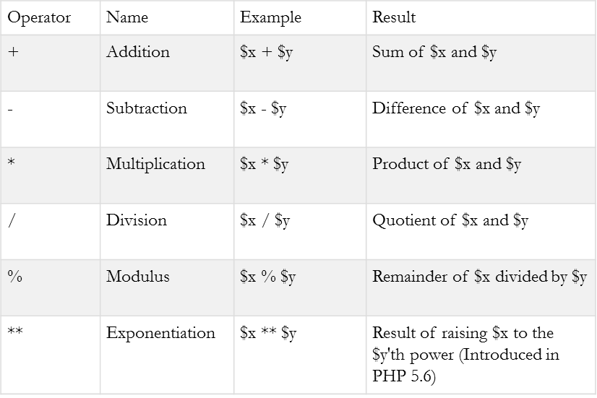
PHP Arithmetic Operators
The PHP arithmetic operators are used with numeric values to perform common arithmetical operations, such as addition, subtraction, multiplication etc.

Slide 6
PHP Assignment Operators
Assignment | Same as... | Description
x = y | x = y | The left operand gets set to the value of the expression on the right
x += y | x = x + y | Addition
x -= y | x = x - y | Subtraction
x *= y | x = x * y | Multiplication
x /= y | x = x / y | Division
x %= y | x = x % y | Modulus
The PHP assignment operators are used with numeric values to write a value to a variable.
The basic assignment operator in PHP is "=". It means that the left operand gets set to the value of the assignment expression on the right.

Slide 7
PHP Comparison Operators
Operator | Name | Example | Result
== | Equal | $x == $y | Returns true if $x is equal to $y
=== | Identical | $x === $y | Returns true if $x is equal to $y, and they are of the same type
!= | Not equal | $x != $y | Returns true if $x is not equal to $y
<> | Not equal | $x <> $y | Returns true if $x is not equal to $y
!== | Not identical | $x !== $y | Returns true if $x is not equal to $y, or they are not of the same type
> | Greater than | $x > $y | Returns true if $x is greater than $y
< | Less than | $x < $y | Returns true if $x is less than $y
>= | Greater than or equal to | $x >= $y | Returns true if $x is greater than or equal to $y
<= | Less than or equal to | $x <= $y | Returns true if $x is less than or equal to $y
The PHP comparison operators are used to compare two values (number or string).

Slide 8
PHP Increment / Decrement Operators
Operator | Name | Description
++$x | Pre-increment | Increments $x by one, then returns $x
$x++ | Post-increment | Returns $x, then increments $x by one
--$x | Pre-decrement | Decrements $x by one, then returns $x
$x-- | Post-decrement | Returns $x, then decrements $x by one
The PHP increment operators are used to increment a variable's value.
The PHP decrement operators are used to decrement a variable's value.

Slide 9
PHP Logical Operators
Operator | Name | Example | Result
and | And | $x and $y | True if both $x and $y are true
or | Or | $x or $y | True if either $x or $y is true
xor | Xor | $x xor $y | True if either $x or $y is true, but not both
&& | And | $x && $y | True if both $x and $y are true
|| | Or | $x || $y | True if either $x or $y is true
! | Not | !$x | True if $x is not true
The PHP logical operators are used to combine conditional statements.

Slide 10
PHP String Operators
Operator | Name | Example | Result
. | Concatenation | $txt1 . $txt2 | Concatenation of $txt1 and $txt2
.= | Concatenation assignment | $txt1 .= $txt2 | Appends $txt2 to $txt1
PHP has two operators that are specially designed for strings.

Slide 11
PHP Array Operators
Operator | Name | Example | Result
+ | Union | $x + $y | Union of $x and $y
== | Equality | $x == $y | Returns true if $x and $y have the same key/value pairs
=== | Identity | $x === $y | Returns true if $x and $y have the same key/value pairs in the same order and of the same types
!= | Inequality | $x != $y | Returns true if $x is not equal to $y
<> | Inequality | $x <> $y | Returns true if $x is not equal to $y
!== | Non-identity | $x !== $y | Returns true if $x is not identical to $y
The PHP array operators are used to compare arrays.

Slide 12
PHP Data types
Variables can store data of different types, and different data types can do different things.
PHP supports the following data types:
String
Integer
Float (floating point numbers - also called double)
Boolean

Slide 13
PHP String
A string is a sequence of characters, like "Hello world!".
A string can be any text inside quotes. You can use single or double quotes:
<?php $x = "Hello world!"; $y = 'Hello world!'; echo $x; echo "<br>"; echo $y; ?>

Slide 14
PHP Integer
An integer is a whole number (without decimals). It is a number between -2,147,483,648 and +2,147,483,647.
Rules for integers:
An integer must have at least one digit (0-9)
An integer cannot contain comma or blanks
An integer must not have a decimal point
An integer can be either positive or negative
Integers can be specified in three formats: decimal (10-based), hexadecimal (16-based - prefixed with 0x) or octal (8-based - prefixed with 0)
<?php $x = 5985; var_dump($x); ?>

Slide 15
PHP Float
<?php $x = 10.365; var_dump($x); ?>
A float (floating point number) is a number with a decimal point or a number in exponential form.
In the following example $x is a float. The PHP var_dump() function returns the data type and value

Slide 16
PHP Boolean
$x = true; $y = false;
A Boolean represents two possible states: TRUE or FALSE.
Booleans are often used in conditional testing.

Slide 17
PHP Global Variables Types.
One is Environmental level and the other is Script level variables.
Environmental level variables are available any where in your PHP program,.
Script level variables are available only externally to functions unless you pass them to a function as an actual parameter.

Slide 18
PHP Predefined Variables.
PHP predefined variables are also known as super global variables which means that they are always accessible, regardless of scope - and you can access them from any function, class or file without having to do anything special.
The PHP superglobal variables are:
$GLOBALS
$_SERVER
$_REQUEST
$_POST
$_GET
$_FILES
$_ENV
$_COOKIE
$_SESSION

Slide 19
Predefined Variables.
Variable Name | Description
$GLOBALS | The variable contains a reference to every variable with in the global scope of the script. The keys for these values are the names of the global variables.
$_COOKIE | The variable contains all HTTP cookies. It replaces the deprecated $$HTTP_COOKIE_VARS array.
$_ENV | The variable contains all inherited environment variables or those directly set within the script. It replaces the deprecated $HTTP_ENV_VARS array.
$_GET | The variable contains all the URL query string values. It replaces the $HTTP_GET_VARS array.

Slide 20
Predefined Variables.
Variable Name | Description
$_SERVER | The variables contains variables set by the execution environment of the web server and current running scripts. It replaces the deprecated $HTTP_SERVER_VARS array.
$_SESSION | The variable contains variables bound to the current session. It replaces the deprecated $HTTP_SESSION_VARS array.
$_FILES | The variable contains all variables provided by HTTP POST file uploads. It replaces the deprecated $HTTP_POST_FILES array.
$_POST | The variable contains all variables provided by HTTP POST it replaces the deprecated $HTTP_POST_VARS array.

Slide 21
Predefined Variables.
$_REQUEST: The variable contains all variables provided by GET, POST, and COOKIE inputs. The order of the variable is set by the PHP variable order configuration parameter. The values in this variable are a security risk because it makes a man-in-the-middle attack more likely, since $_GET is insecure. You should use the $_POST in place of the $_REQUEST predefined variable.

